Slide 2
Explore AI Learn Path Learn, Build & Grow with AI Presented by: Sharda Kaur Microsoft Beta Student Ambassador
Subtitle or speaker name

Slide 3
Agenda of the Session:
Understanding AI
AI in the Real World
Explore AI Learn Path Overview
Hands-on Demo
Q&A

Slide 4
Understanding AI
What is Artificial Intelligence (AI)? AI enables machines to think, learn, and make decisions.
Types of AI:
Machine Learning (ML): AI models that learn from data.
Deep Learning (DL): Advanced ML using neural networks.
Natural Language Processing (NLP): AI that understands human language (e.g., ChatGPT, Siri, Google Assistant).

Slide 5
Real-World AI Examples:
ChatGPT & Microsoft Copilot
AI in Healthcare (diagnosis, robotic surgery)
AI in Finance (fraud detection, stock prediction)
AI in Education (personalized learning)

Slide 6
Why AI is the Future?
AI is growing fast!
Every industry is using AI: IT, Healthcare, Banking, E-commerce, and more.
AI-powered automation is increasing efficiency.
Job opportunities in AI are booming (Data Scientist, AI Engineer, etc.).
Statistics on AI Growth (Optional):
AI market is expected to grow to $900 billion by 2026.
85% of companies are integrating AI in some way.

Slide 7
Explore AI Learn Path Overview
What is Microsoft Learn? A free platform by Microsoft to learn new technologies interactively.
What Will You Learn?
AI Basics
Machine Learning Models
Azure AI Services
Hands-on AI projects

Slide 8
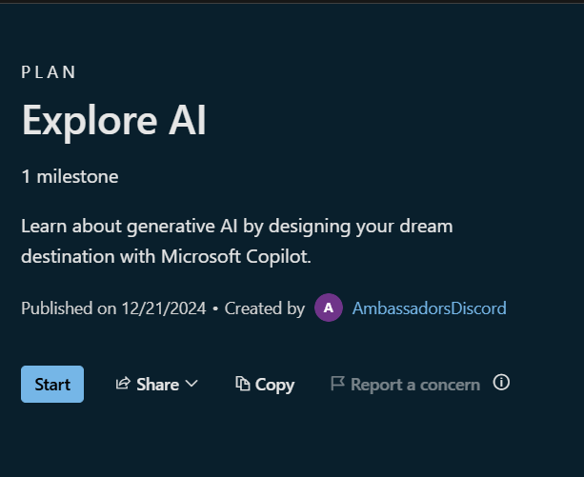
BENEFITS
Learn AI from scratch.
Get a completion badge from Microsoft.
Build skills for AI careers.

Slide 9
How to Get Started?
Step 1: Click the invite link → Explore AI Learn Path
1
Step 2: Sign in with Microsoft account.
2
Step 3: Start learning and complete modules. Step 4: Earn your badge and showcase on LinkedIn!
3

Slide 10
Next Steps & Call to Action
What to do after this session?
Complete the Explore AI Learn Path.
Share your badge on LinkedIn and tag me!
Keep learning AI & explore more Microsoft Learn resources.
Connect with me on LinkedIn for future events & guidance.

Slide 11

THANK YOU

